Slide 1

Microsoft Movie Analysis
Presentor: Jennifer Casias

Slide 2

Microsoft has created a new movie studio
Key Business Questions:
Production budget
ROI
Profitable Months
Profitable Genres
Notes:
Does production budget affect gross income?
What is the return on income?
Which months take in the most revenue?
What are the most profitable genres?

Slide 3

Data
Box Office Mojo
The Numbers
Rotten Tomatoes Info & Reviews
IMDB
Notes:
Box Office Mojo - domestic gross, foreign gross and year
The Numbers - worldwide gross, domestic gross, production budget
Rotten Tomatoes Info - rating, genre, director, writer, box office , run-time, studio
RT Reviews - review, rating, fresh, top critic, critic

Slide 4

Process Steps
BO Mojo & The Numbers
Last ten years
Profit & ROI
Rotten Tomatoes
Mel Gibson?!
Top Genres
Peak Months

Slide 5
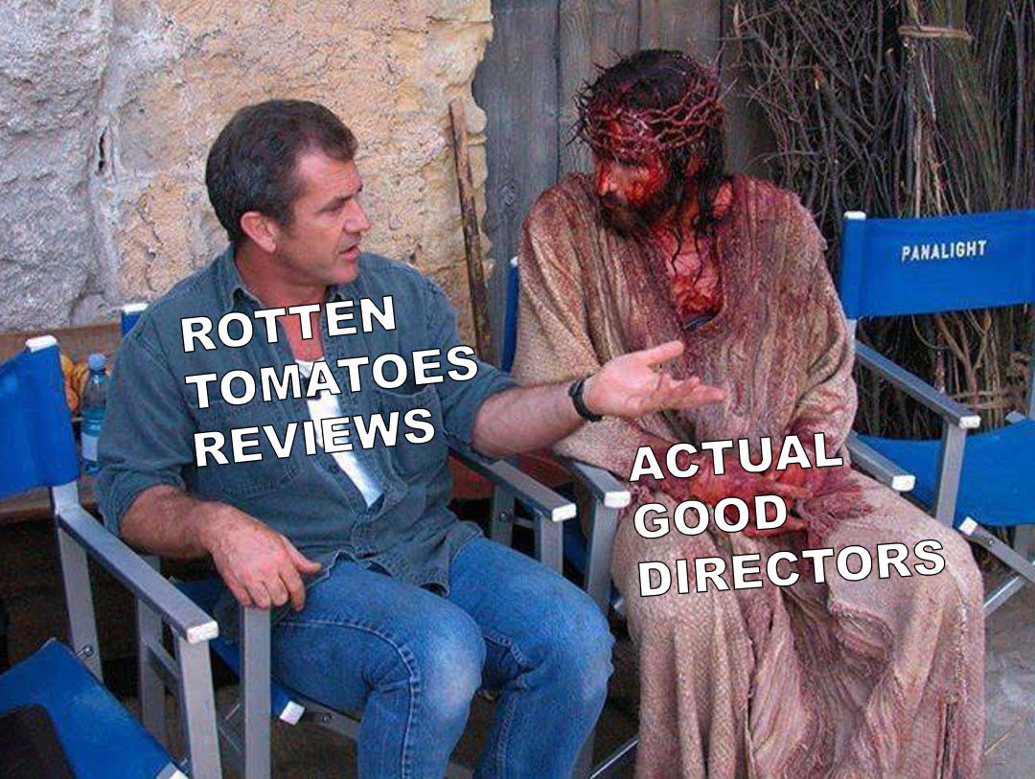
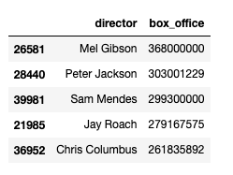

Slide 6
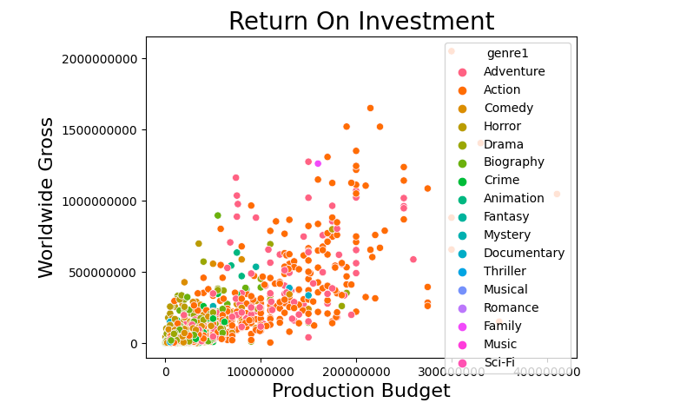
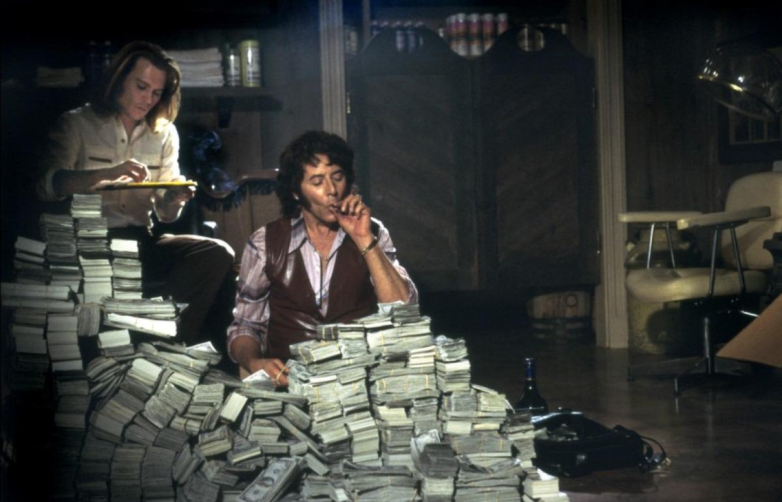
Data
Big Budget = Big Return
Positive correlation

Slide 7
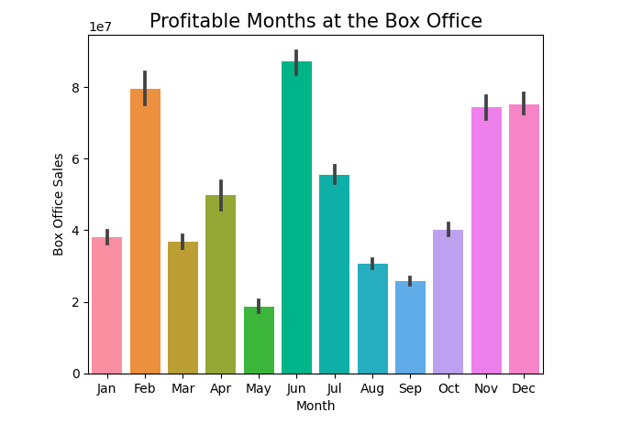
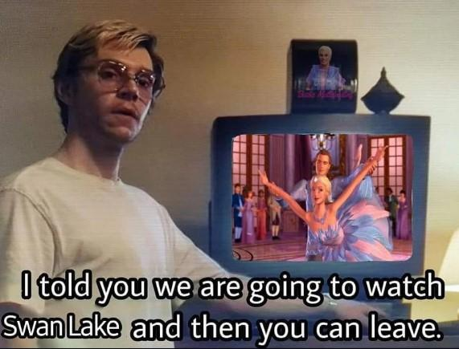
Top Months
Top Months
June
November
December
February
July

Slide 8
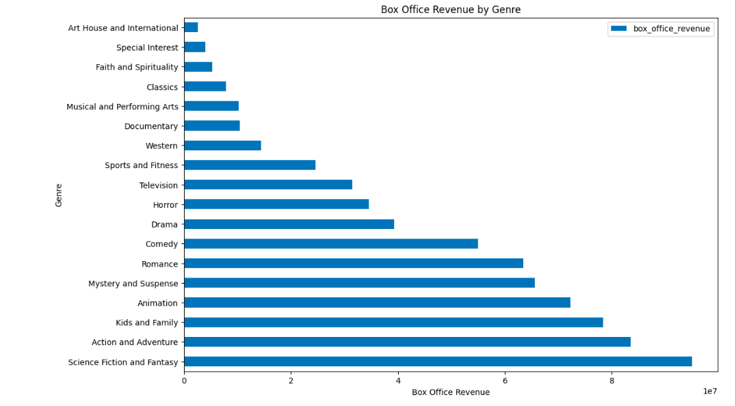

Slide 9
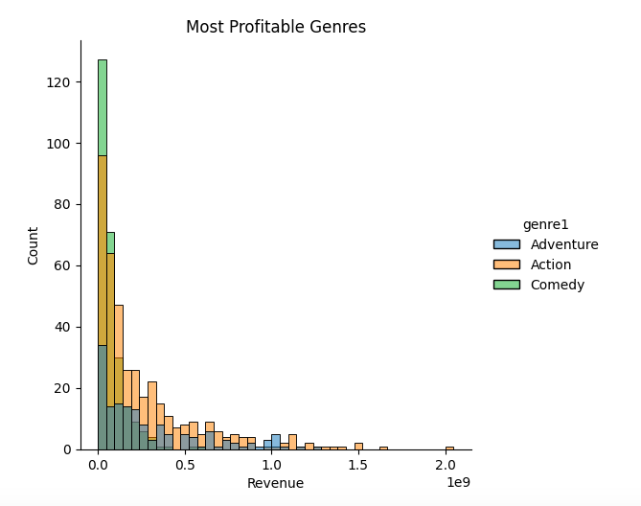

Genres by Profit
(insert graph)
Notes:
Star Wars is the most profitable movie in history according to the Hollywood Reporter

Slide 10

Insights
Budget and Revenue are positively correlated.
Months to release
June-July
Nov-Dec
Feb
Genres to consider
Adventure
Action
Comedy
Notes:
However, high budget does not guarantee high revenue.

Slide 11

Evaluation & Future Improvement Ideas
Go more in depth on genres by month.
February?
Cinema attendance
2001-2007: 4.8
2021: 1.4
Factors
Age groups
Gen Z 34%
BB 9%
Streaming services

Slide 12
Jennifer Casias
email: casiasjc@gmail.com

